Slide 1
Engineering Project Management
Hat 213
Lecture 8:
Engineering and Technology
Management Tools and Applications
Reference Book: Engineering and Technology Management Tools and Applications
1
Notes:
Dr Mahdi

Slide 2
Introdution
since World War II, there has been a considerable growth in the development of quantitative management techniques and methods. The new developments in computer technology and the complexities of modern management decision making problems have enhanced the importance of many of these quantitative approaches. Some examples of these methods are linear and nonlinear programming techniques.
These approaches include discounted cash flow analysis, depreciation analysis, decision trees, optimization techniques, learning curve analysis, fault tree analysis, and forecasting.

Slide 3
Optimization Techniques
There are many optimization techniques, and two of the best known methods are linear programming and Lagrangian multiplier.
Linear Programming Method
This is probably the simplest and the most widely used method of optimization subject to constraints.
Past experience indicates that the application of the linear programming method has helped production and operations managers plan and make effective decisions to allocate available resources.

Slide 4
Linear Programming
All linear programming problems have the following properties in common:
The objective and constraint functions are expressed in terms of linear equations or inequalities.
The problems aim to minimize or maximize some quantity (e.g., cost or profit).
There are alternative courses of action from which to choose.
The presence of constraints limits the persuasion of the objective.

Slide 5
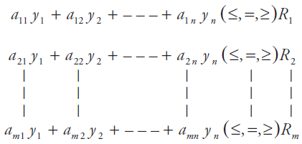


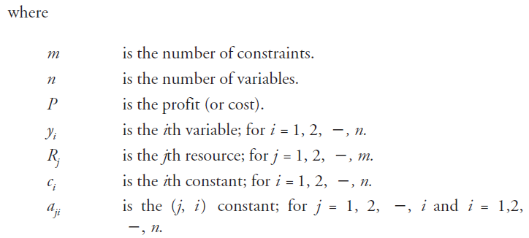
Simple Problem Formulation
Subject to
…

Slide 6
Example:
A company manufactures two types, (i.e., A and B) of an engineering product. The product uses three different parts, say, X, Y, and Z. In the company storage, there are 40 type-X parts, 50 type-Y parts, and 16 type-Z parts. Each product type A uses five type-X parts and five type-Y parts. Similarly, the product type B uses four type-Z parts and four type-Y parts. Each unit of A and B makes a profit of $30 and $15, respectively.
Determine the units of A and B to be manufactured to maximize profit and compute the total maximum profit.

Slide 7

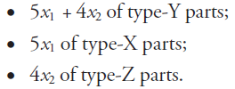
Example cont.
The total profit is expressed as follows:
Where,
The available parts are used as follows:

Slide 8
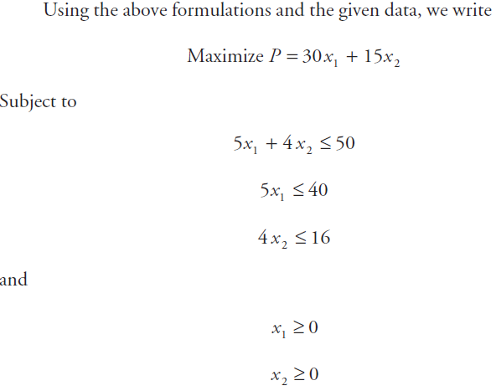
Example cont.
As this problem has only two variables, it can be solved graphically.

Slide 9
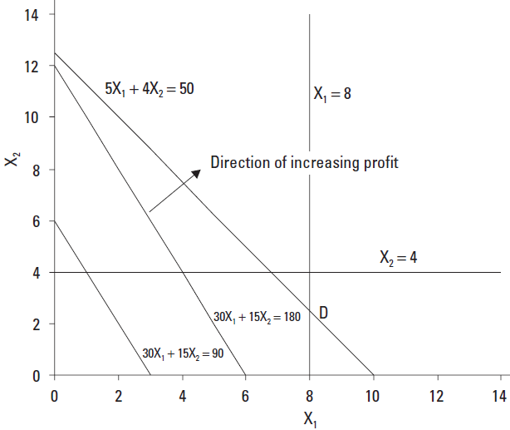

Example cont.
The profit will be maximum at point D. At this point all constraints are satisfied
At this point D, the values of x1 and x2 are 8 and 2.5,

Slide 10
Learning Curve Analysis
Past experience indicates that individuals learn by experience.
The learning curve theory is based on assumptions such as:
The time required to complete a specified task or unit of a product or item will be less each time the task is performed.
The unit time will reduce at a decreasing rate.
The learning curves may vary from one product to another and from one organization to another.
Any change in personnel, process, or product disrupts the learning curve.
An 80% learning rate is descriptive of certain operations in such areas as ship construction.

Slide 11

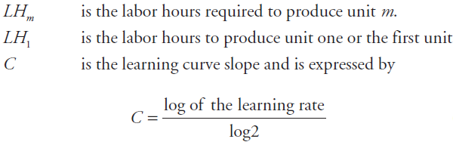


Learning Curve Cont.
An 80% learning rate means the second unit takes 80% of the time of the first unit, so we may write:
Example
Assume that the learning rate for a certain operation is 75% and it took 90 hours to produce the first unit. Calculate the hours required to produce the fifth unit.
= - 0.415

Slide 12
Forecasting
Each day engineering managers make various decisions that are concerned with some point in the future.
Forecasting is a useful tool to estimate demand for a certain product, and it may simply be described as the art and science of predicting future events.
Forecasts types are: Technological, demand and Economic.
Time Horizons of forecasts are: Long-range, medium-range and short-range.

Slide 13
Forecasting Steps
A useful forecasting approach is composed of the following eight steps :
Determine the forecast application and objective.
Choose with care the items to be forecasted.
Determine forecast time horizon (i.e., long, short, or medium).
Choose appropriate forecasting model(s).
Collect the appropriate data required to make the forecast under consideration.
Validate the forecasting model with care.
Make all relevant forecasts.
Implement the appropriate results.

Slide 14
Forecasting Methods
The forecasting methods may be divided into two broad categories: qualitative and quantitative.
The qualitative methods provide forecasts that incorporate factors such as the decision maker’s emotions, personal experiences, and intuition. Example is consumer market survey.
The quantitative methods provide forecasts that were obtained by employing various mathematical models that use past data or causal variables to forecast demand. Examples of the quantitative methods include exponential smoothing, moving averages.

Slide 15



Simple Average
This is a simple and straightforward method in which the demands of all previous periods are given equal weight. Thus, the simple average of the past is expressed by:
Example
Assume that in the past four 5-month periods, the demand for a certain company product was 200, 150, 100, and 250 units, respectively. Determine the simple average of demands.
It means a forecast for demand for a future 5-month period is 175 units.

Slide 16
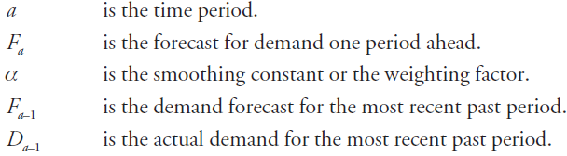

Exponential Smoothing
This is a frequently used and sophisticated weighted moving-average forecasting method.
The basic exponential smoothing formula is:
Where,
The generalized version is:

Slide 17
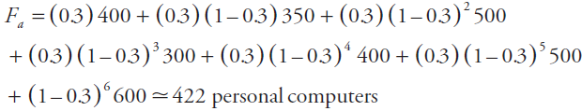
Example:
Assume that a computer manufacturer sold 500, 400, 300, 500, 350, and 400 personal computers for the months of January, February, March, April, May, and June, respectively. The forecast for January was 600 personal computers to be sold. Forecast the number of personal computers to be sold by the manufacturer for the month of July, if α = 0.3.
It means that the manufacturer should expect to sell 422 personal computers for the month of July.

